Slide 1
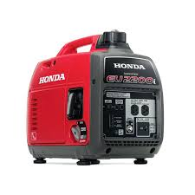
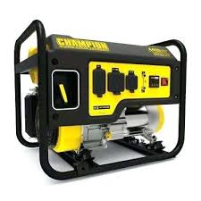
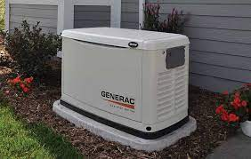
Emergency Generators
Gwinnett Amateur Radio Society
September 21, 2021

Slide 2
Generators
What You Need To Know To Select The Best Option For You
What causes power outages?
Type of fuel to use
Types of generators
Generator size
Operations & Safety
Costs

Slide 3
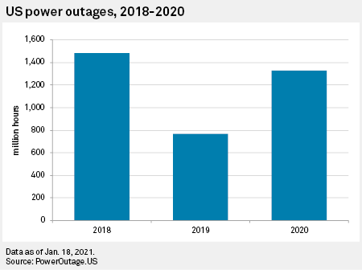
u.s. Power Outages in Millions of Hours
Simple Math
1.33B Hours
Divided by
128M Households
= 10.4 Hr. Avg.
1.48
Billion
Hours
1.33
Billion
Hours
Most outages will
only last a day or
two, but some will
last a couple of
weeks
770
Million
Hours

Slide 4
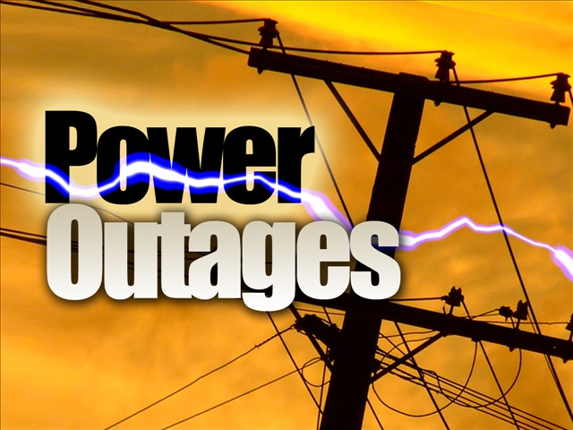
What Causes Power Outages?
Weather
High Power Demand
Aging Transmission Lines
Cyber Attacks
EMP
Coronal Mass Ejection
Construction Digging
Animals
Up to 30% of Power Outages are due to squirrels

Slide 5
Weather related Causes
Wildfires & Extreme Heat 2%
Cold Weather
& Ice Storms
20%

Slide 6
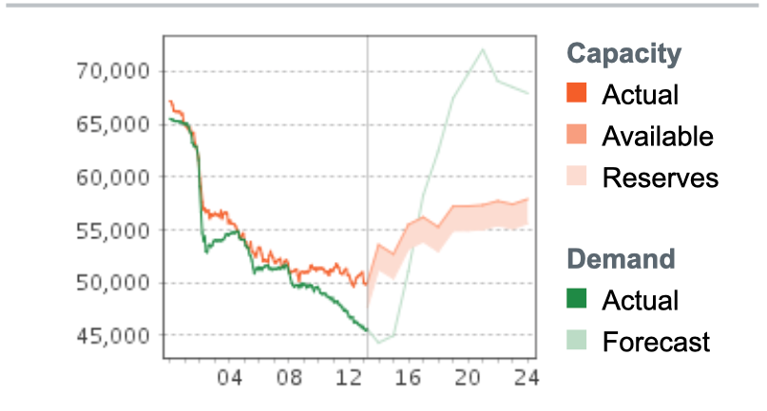
High Power Demand
Georgia Power offers a phone app to track capacity & demand

Slide 7
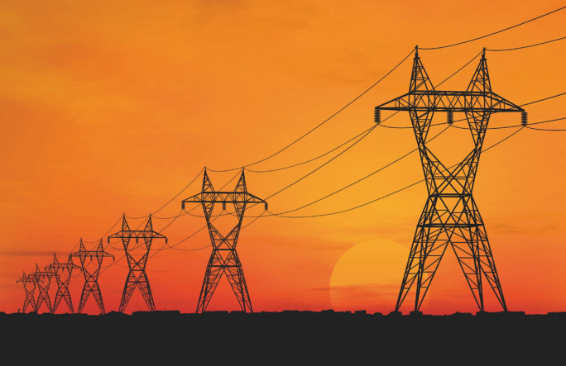
The American Society of Civil Engineers report that many electric transmission and distributions lines were constructed in the 1950s and 1960s with a 50-year life expectancy. The average age is 40 years and 25% are age 50 or more
Dr. Joshua Rhodes of the University of Texas Energy Research Department estimates replacement cost to be 1.5 – 2 Trillion dollars.
The Infrastructure Bill includes $73 Billion

Slide 8
Notable Power Grid Cyber Attacks
2015 & 2016 – Kiev Ukraine attack by Russia
2017 – Saudi Arabia oil fields attacked by Iran
2017 – Burlington Vermont by Russia
2019 – Russia attack by ???
2020 – European Union “Successful Cyber Intrusion”
2021 - Mumbai India attack by China

Slide 10
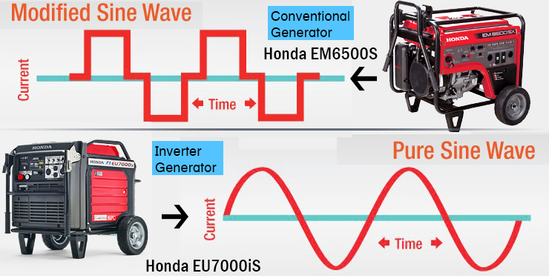
Conventional vs Inverter
CONVENTIONAL
Invented in 1831 by Faraday
Produces one block wave of AC power for each rotation of the generator
To produce US standard 120V/60Hz it must turn at a constant 3600rpm
INVERTER
Invented in 1987 by Honda
Step 1 produces AC power which is converted to DC
Step 2 an electronic inverter converts it back to 120v/60Hz AC power
This produces a pure sine wave with less harmonic distortion

Slide 11
What Difference Does It make?
Feature | Conventional | Inverter
Fuel Cost
Efficiency
Power
Cost
Noise
Better
Not as Good

Slide 12
Comparison
CONVENTIONAL
Straight AC power
Available 700 – 150,000 watts
Runs full throttle
Significantly less initial cost for equal power output
Less complex
INVERTER
AC converted to DC inverted to AC
Available 1000 – 7000 watts
Variable Speed based on load
Quieter
Smaller & lighter
Clean, consistent power
Can be run in parallel
More expensive

Slide 13
Which is Best?
Depends on your use and budget

Slide 14
Which Type Fuel ?
Gasoline
Diesel
Natural Gas
Liquid Petroleum Gas (LPG)/Propane
Dual Fuel (Gasoline or Propane)
Multiple Fuel (Gasoline / Propane / Natural Gas )

Slide 15
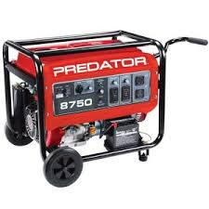
Gasoline Power
PRO
CON
Refueling danger due to spillage on a hot engine
Fuel storage fire issues
Fuel degrades over time
E0 gas hard to find, E10 gas gunks up the carburetor
Constant 3600 rpm speed
Lowest initial Cost
Wide availability

Slide 16
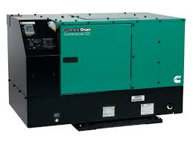
Diesel Fuel
PRO
CON
Long standing proven technology
Runs at 1800 rpms instead of 3600 rpms
Longer run time & durability
Low storage fire risk
Higher initial costs
Diesel degrades over time
Emission regulations require ultra-low sulfur diesel which is less stable
Rising fuel costs

Slide 17
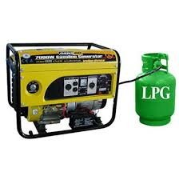
LPG/Propane
PRO
CON
Fuel stored on site
Unlimited shelf-life
Runs clean without carburetor fouling
Constant 3600 rpm run speed
Power output less than a gas or diesel fueled generator
Fuel tanks only filled to 80% capacity

Slide 18
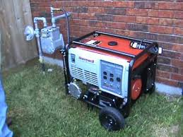
Natural Gas
PRO
CON
No fuel storage issues
No refueling issues
Low fuel costs
Some run at 1800 rpms other at 3600 rpms
Fuel supply delivery outside your control
In an emergency delivery is subject to prioritization and containment

Slide 19
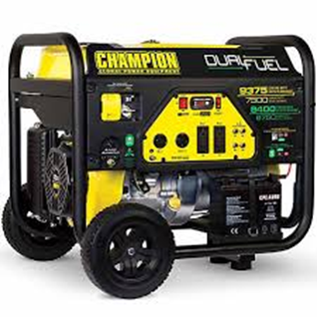
Dual & Multi-fuel
PRO
CON
Take advantage of preferred fuel type, with a back-up capacity if that fuel is unavailable
Better manage refueling issues
Higher initial cost
Power is 10% less when running on natural gas or propane
Storing multiple fuels more complex

Slide 20
Comparing Fuel Costs
Factor | Gasoline | Diesel | Propane | Natural Gas
Generator Size | 5 kW | 20kW | 20kW | 22kW
Unit Cost | $2.98/gal | $3.15/gal | $2.75/gal | $0.65/ccf
Use/Hr. | 0.75 gal | 1.6 gal | 1.89 gal | 2.28ccf
Cost/Hr. | $2.24 | $5.04 | $5.20 | $1.48
Cost/Day | $53.64 | $120.96 | $124.74 | $35.57
Cost/kWh | $0.45 | $0.25 | $0.26 | $0.07

Slide 21
Sizing your Generator
Make a list of the items that need to be powered by the generator.
Make a note of the running and starting wattage of the respective items.
Total the wattage requirements using the starting wattage for items that require them.
Allow at least 25% above the running wattage total
Note best fuel efficiency is running at 50% load

Slide 22
Examples to Consider
Basic Items
Running Watts Starting Watts
Refrigerator w/freezer 700 2200
Deep Freezer 500 1500
Six 75w light bulbs 450
Radio 30A power supply 300
Phone charger 20
TOTAL Needed 4470 Watts
Optional Items
Laptop 200 watt
10,000 BTU Room A/C 1200/3600
Box Fan 200
Microwave 1200
Coffee Maker 1000
Space Heater 1800
TV 27” 500
DVD 100

Slide 23
Small Invertor 2000W Choose what you can run
Basic Items
Running Watts Starting Watts
Refrigerator w/freezer 700 2200
Deep Freezer 500 1500
Six 75w light bulbs 450
Radio 30A power supply 300
Phone charger 20
TOTAL Needed 4470 Watts
Optional Items
Laptop 200 watt
10,000 BTU Window A/C 1200/3600
Box Fan 200
Microwave 1200
Coffee Maker 1000
Space Heater 1800
TV 27” 500
DVD 100

Slide 24
Medium Generator 4500W Choose what you can run
Basic Items
Running Watts Starting Watts
Refrigerator w/freezer 700 2200
Deep Freezer 500 1500
Six 75w light bulbs 450
Radio 30A power supply 300
Phone charger 20
TOTAL Needed 4470 Watts
Optional Items
Laptop 200 watt
10,000 BTU Window A/C 1200/3600
Box Fan 200
Microwave 1200
Coffee Maker 1000
Space Heater 1800
TV 27” 500
DVD 100

Slide 25
Larger Generator 7000W Choose what you can run
Basic Items
Running Watts Starting Watts
Refrigerator w/freezer 700 2200
Deep Freezer 500 1500
Six 75w light bulbs 450
Radio 30A power supply 300
Phone charger 20
TOTAL Needed 4470 Watts
Optional Items
Laptop 200 watt
10,000 BTU Window A/C 1200/3600
Box Fan 200
Microwave 1200
Coffee Maker 1000
Space Heater 1800
TV 27” 500
DVD 100

Slide 26
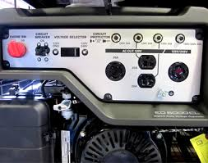
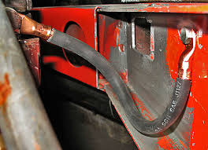
Should portable Generator be grounded
OSHA states the frame of a portable generator need not be grounded (connected to earth) and that the frame may serve as the ground (in place of the earth),
IF
The generator supplies only equipment cord and plug connected equipment through receptacles mounted on the generator 1926.404(f)(3)(i)(A)
The noncurrent carrying metal parts of
equipment are bonded to the generator
frame AND the equipment grounding
conductor terminals that are part of the
generator are bonded to the generator
frame.
1926.404(f)(3)(i)(B)

Slide 27
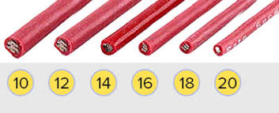
Device Requirements & Max Cord length by Wire Gauge
Amps | Watts | #10 | #12 | #14 | #16
10A | 1200 | 250’ | 150’ | 100’ | 50’
20A | 2400 | 125’ | 75’ | 50’ | -
30A | 3600 | 65’ | - | - | -
Make Sure the Power Cord is Rated for Outdoor Use

Slide 28
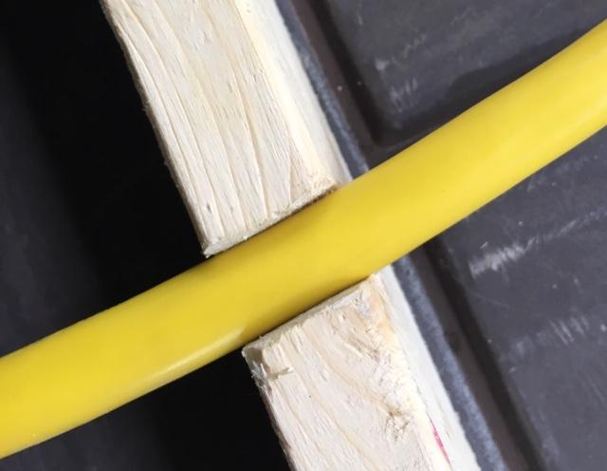
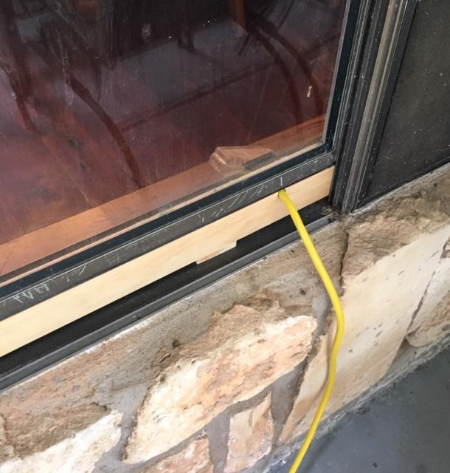
How to Run your power cords through the window
Cut a notch
in a board
Sized to fit the
power cord
Temporary
Power
outlet
Cut the board
To fit the
window

Slide 29
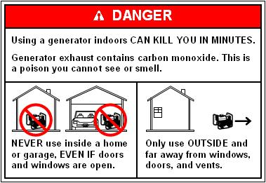
Portable Generator safety

Slide 30
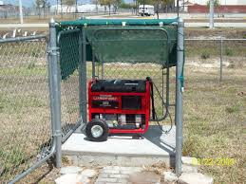
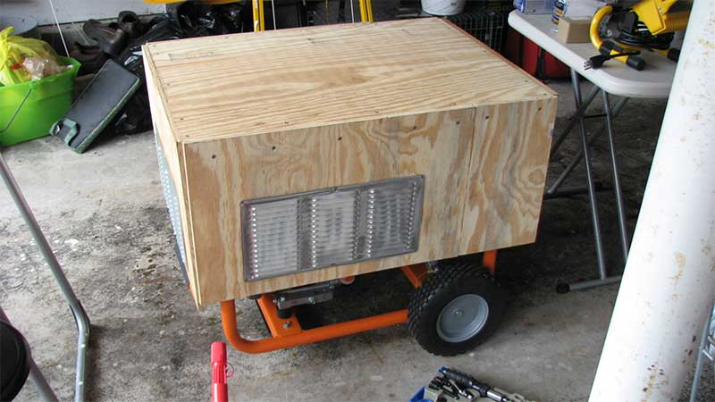
Keep the generator dry
Keep outlets 100% dry
Maintain air flow
Be sure the enclosure can handle the elements and wind

Slide 31
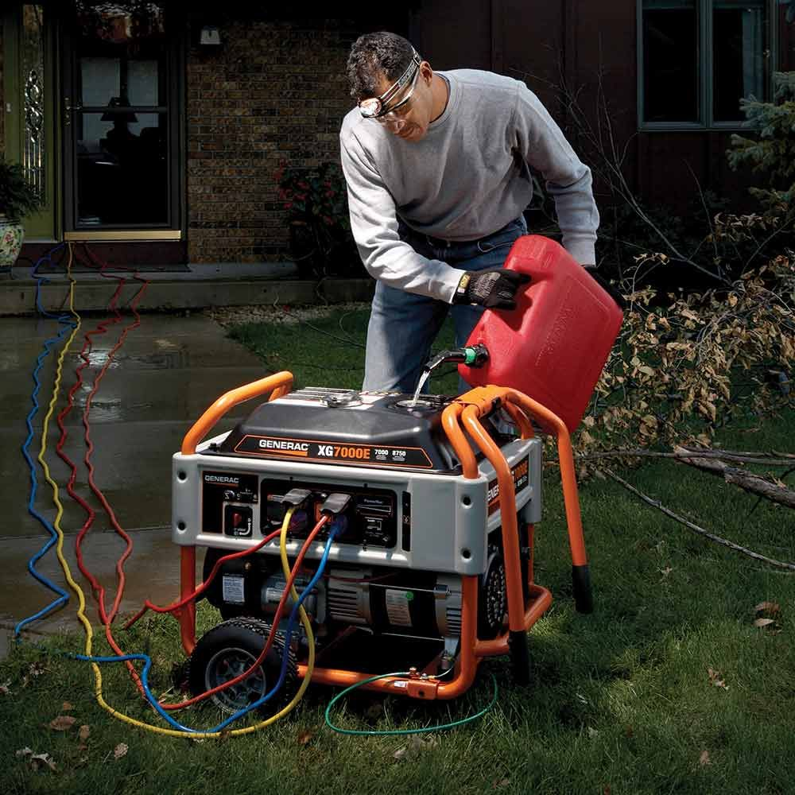
Gasoline Refueling Safety
Turn the generator off and let it cool for 2 minutes before taking off the gas cap
Do not let gas spill on the hot engine
Do not overfill

Slide 32
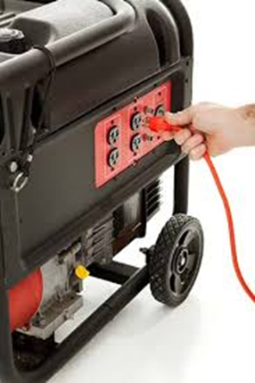
Connecting to the generator
Start the generator
Allow it to run for 2-5 minutes to stabilize
Plug in the highest draw item
Allow the engine to stabilize
Repeat plugging in one item at a time, followed by allowing the engine to stabilize

Slide 33
Stopping the Generator
Turn off and unplug each electric load, one at time
Run the generator at no load for several minutes
Turn off the fuel valve until fuel starvation has stopped the engine
Turn off the engine switch
Remove the spark plug cap
Crank the engine to drain any gasoline from the carburetor jets
Clean the carburetor
Drain the fuel tank
Continue if a gasoline engine

Slide 34
Portable Generator Run Time
Generator will last for 1000 to 2000 hours before engine replacement
Continuous run time limited to 6-12 hours, before you must let it cool down
One option is to have 2 generators and switch back and forth every 8 hours.

Slide 35
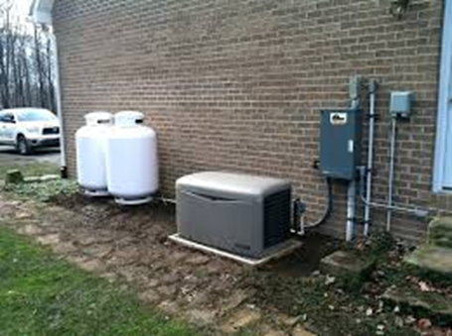
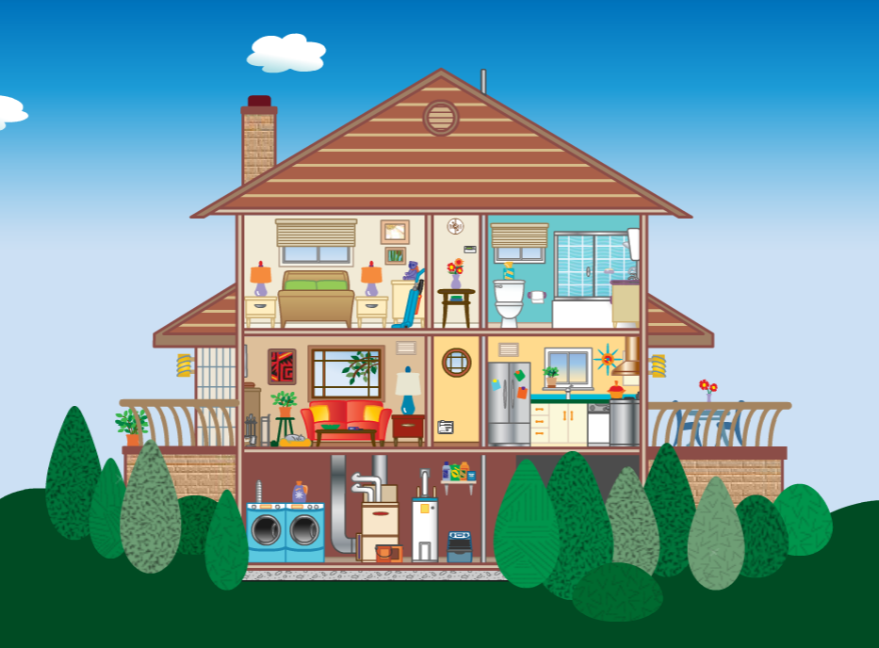
Home Standby generators
Air Cooled Critical Circuits 7.5 – 15kW
Air Cooled Whole House 17 – 22kW
Liquid Cooled Whole House 24 – 60kW
Liquid Cooled Generators Cost $10K Extra
Requires a Manual or Auto Transfer Switch

Slide 36
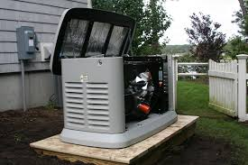
Home Generator Details
Allow extended run time
Can run your whole house or only critical circuits
May Include your A/C
Requires a starting battery
Maybe air cooler or water-cooling
Requires a transfer switch which must be installed by a licensed
electrician

Slide 37
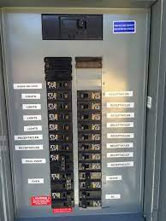
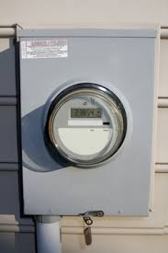
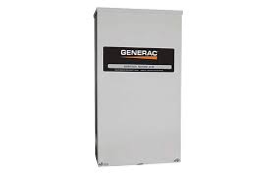
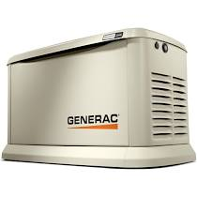
Auto Transfer Switch
ATS detects utility outage
IF power still out after 10 seconds, auto engine start
Engine warms for 5 - 20 seconds, depending on temperature
Generator starts and is at full capacity in 5 seconds
ATS switches to generator power

Slide 38
Impact of Load on Fuel Costs Georgia Natural Gas for 22kW generator
Fuel
Consumption
Per Hour
228cft. $1.42 $34.08 $579.36
309cft. $2.01 $48.20 $819.40
12 mo. fixed
Cost/therm
$.65
$.65
Cost Cost Cost
Per Hr. Per Day 17 Days*
½ Load
Full Load
* Texas Snowmageddon = 17 days

Slide 39
Generac | Kohler | Cummins | Briggs & Stratton
7.5kW
10kW | 10kW |  | 10kW
 | 12kW | 13kW | 12kW
14kW | 14kW
15kW
18kW |  |  | 17kW
20kW | 20kW | 20kW | 20kW
22kW
24kW | 24kW
25kW |  |  | 25kW
27kW
30kW | 30kW | 30kW | 30kW
32kW
36kW
38kW | 38kW
45kw
48kW | 48kW
60kW | 60kW
Available
Sizes
By Brand
Google
Generator Calculator
to determine
operating size
Air Cooled
Critical Circuit
Air Cooled
Whole House
Liquid Cooled
Whole House

Slide 40
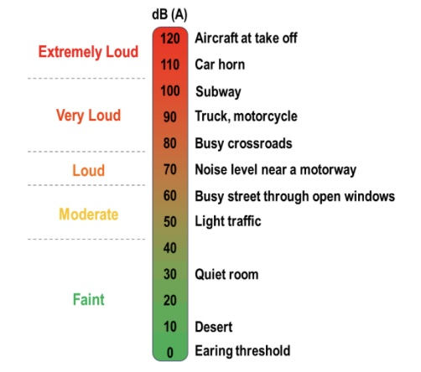
Noise Level
Home Standby
Generators
Are Rated at
64dB to 69dB
At 21 feet
70 dB is 10 Times
Louder than 60 dB

Slide 41
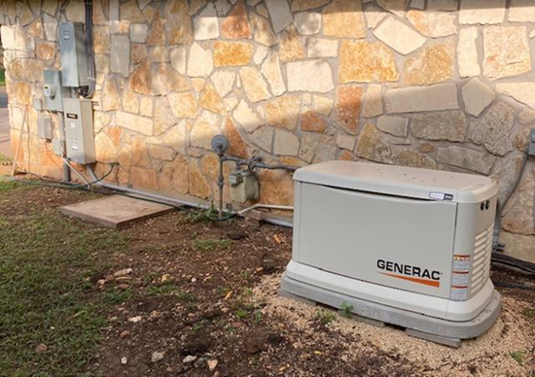
Generator Placement
Must be 5 feet from a window
Must be 5 feet from the gas meter
Distance between generator, gas meter and breaker box is a major factor in installation costs
Gas line must be 1” or larger
Noise level factors (distance to neighbors, brick vs shrubs)
Is gas meter near electric meter?

Slide 42
Whole House Generator Maintenance
Bi-Weekly Auto Test Run
Programmed to run at day/time certain to keep engine lubricated & battery tested
Run Time 5 minutes
3600 rpm for 10 sec.
2400 rpm for 30 sec.
1800 rpm for 4 min. 20 sec.
Run Time Maintenance
After 200 hrs. run time
Change oil & filter
Check battery electrolyte level
After 400 hrs. run time
Change air filter
Check sparkplug gaps or replace if necessary

Slide 43
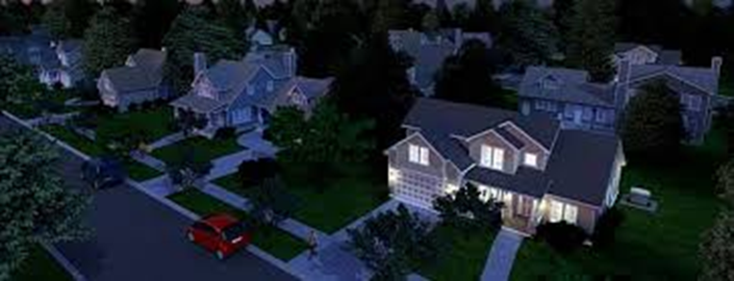
Basic Planning Costs
Installation Costs Major Factor
GENERATOR | WATTAGE | TYPICAL COST
Recreational Inverter | Up to 2000W | $650-$1500
Mid Size Inverter | Up to 3500W | $870-$1500
Large Inverter | Up to 7000W | $1250-$4600
Portable Generator | Up to 7500W | $790-$1400
Home Standby Generator | Up to 22Kw | $8000-$15,000
Diesel | 10Kw-24Kw | $15000-$25,000

Slide 44
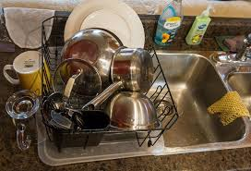
What if you
don’t have
a generator?

Slide 45
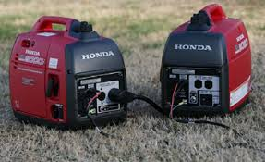
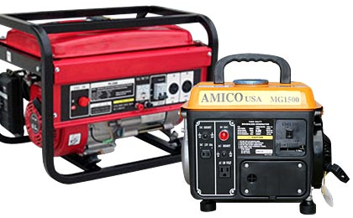
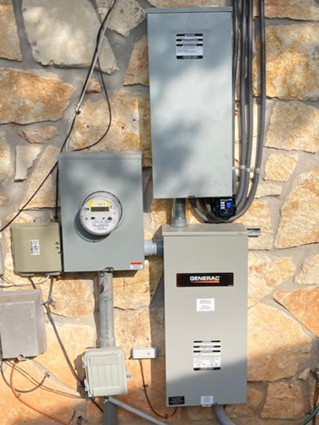
Questions/Comments

